Slide 1
Plant Gundernhausen – NVH Situation

Slide 2
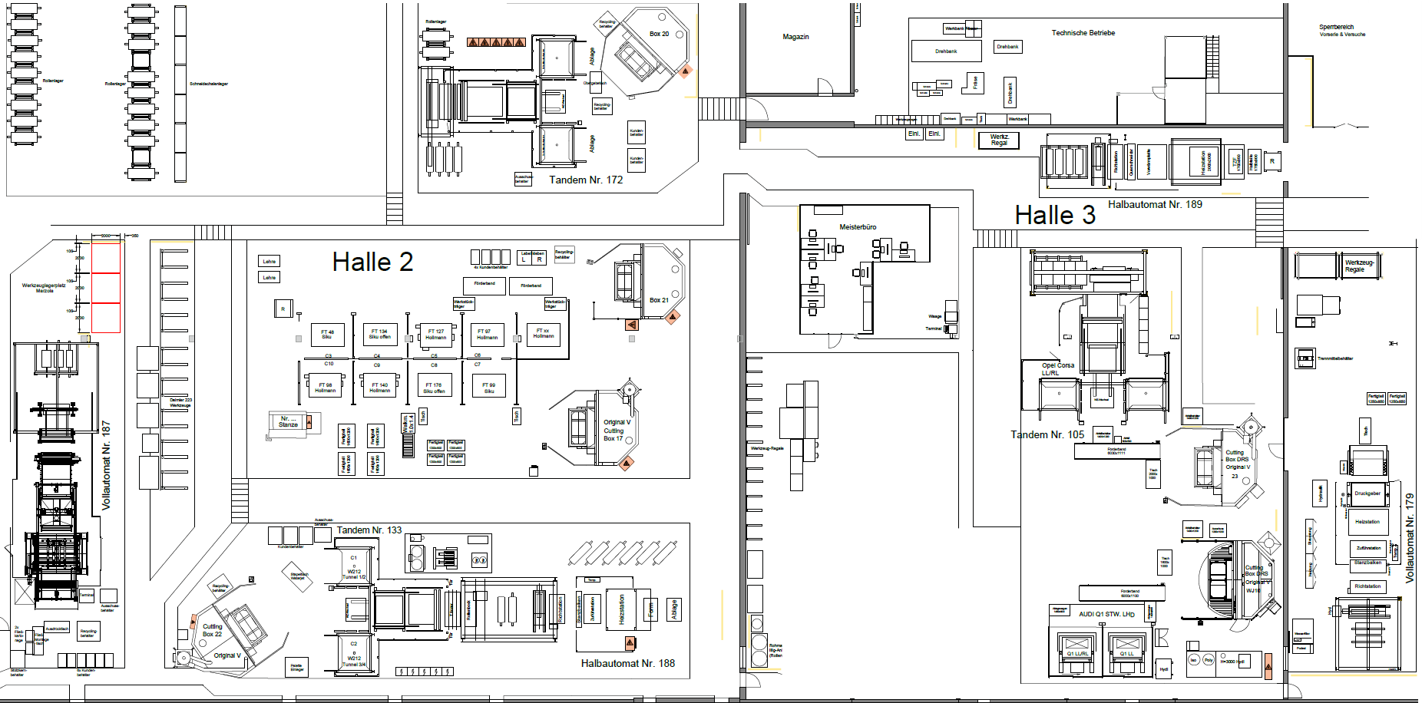
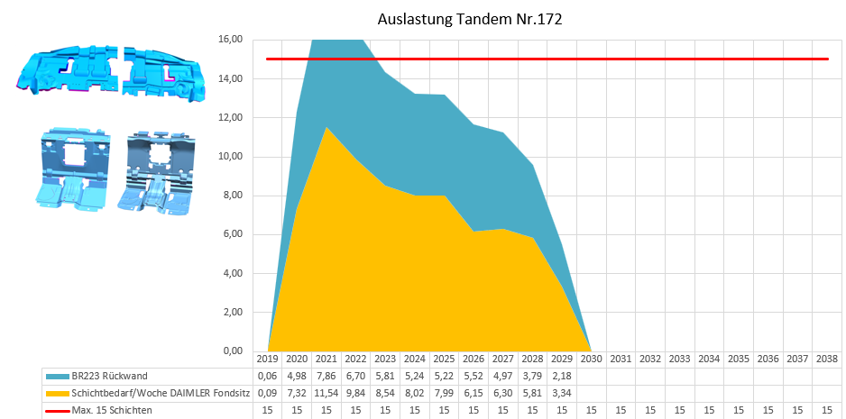
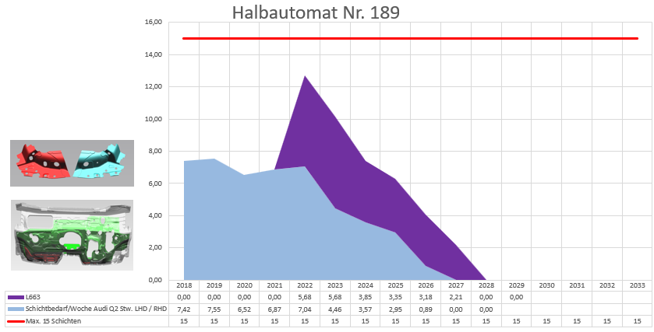
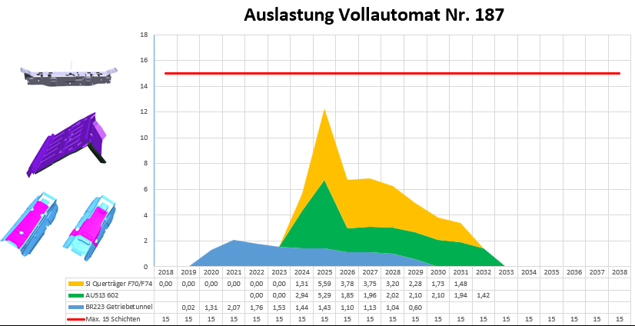
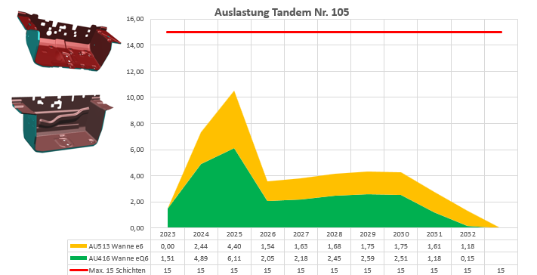
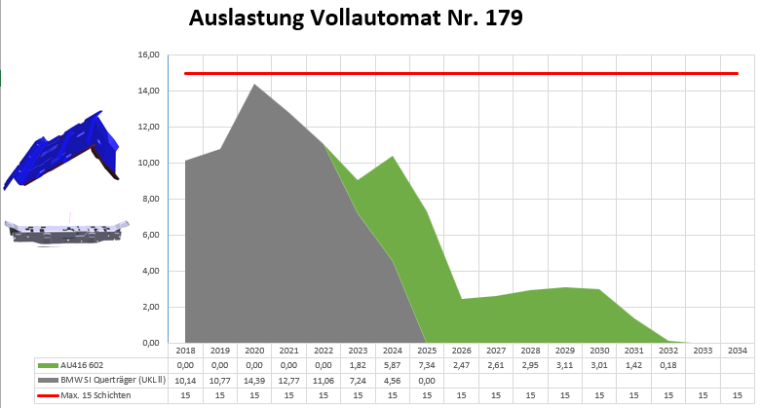
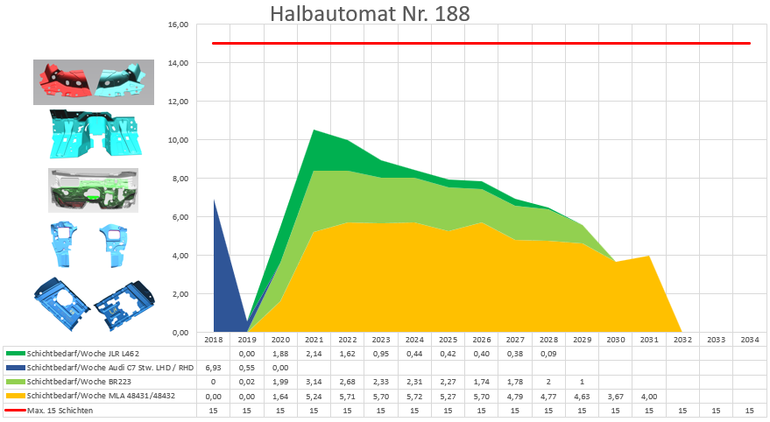
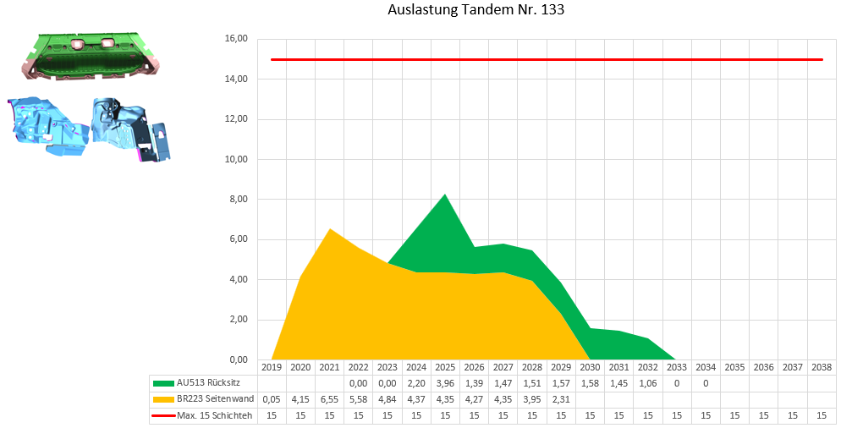
Current OCU (30.03.26 Sonar)
Plant Gundernhausen – NVH Situation

Slide 3

Target Situation
Plant Gundernhausen – NVH Situation

Slide 4
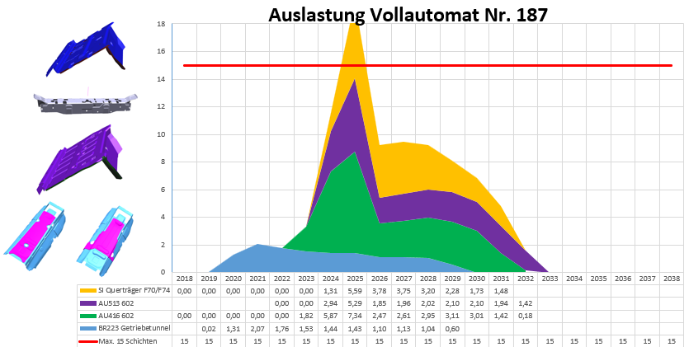
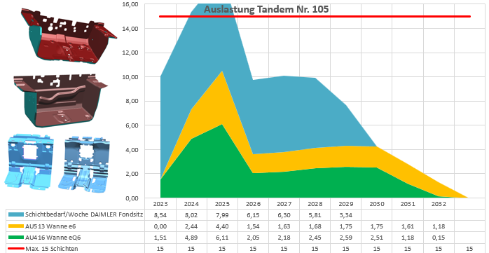
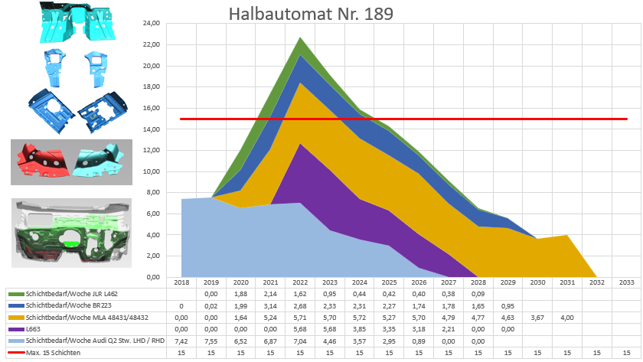
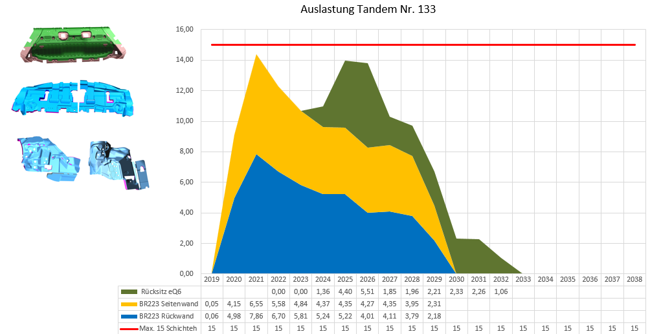
Target Situation
Halbautomaten / Vollautomaten
KW17 M8E2 Bewertung
KW18 L8B2 / 602 A comp ??
KW19 602 A comp ?? Und 545
Tandem nach Kunde oder Mischkopf
KW 20 T105 AUDI? Oder Fondsitz
KW 21 T133 BR223? Oder 545 A
Plant Gundernhausen – NVH Situation

Slide 5
Advantages and Disadvantages
Plant Gundernhausen – NVH Situation
Advantages
Number of systems reduced from 7 to 4
Reduce energy costs
Fewer systems to maintain
Long transport distances for foam to T172 eliminated (system issue)
Semi-automatic line in Hall 2 is very maintenance-intensive, low output
UKL II must be welded again
Disadvantages
Higher number of tool change over
Productivity?
UKL II faster than Marzola → PE to improve

